Slide 1
Week 2 – Hands-on tutorial
RapidMiner BI tool – Installation guide

Slide 2
Introduction
Data preparation is one of the main points at which human creativity, common sense, and business knowledge come into play.

Slide 3
Introduction
Data preparation: a data preparation phase proceeds along with data understanding, in which the data is manipulated and converted into forms that yield better results.
Converting data to tabular format
Removing, replacing or inferring missing values
Converting data to different types

Slide 4
RapidMiner
A data science platform that unites data prep, analytics and deployment

Slide 5
RapidMiner - Introduction
RapidMiner is open source software for educational purposes and is cost-free. A free license and a free software.
Open source software refers to the software providing source code that anyone can inspect, modify and enhance.
Using open source software is a great way to save cost and get the job done.

Slide 6
RapidMiner - Installation
Step 1: On your PC or laptop, go to Start, type “About your PC” and then select it. The following page will open and you will find the type of your system.
Find your system type here.

Slide 7
RapidMiner - Installation
Step 2: Go to the RapidMiner website: https://my.rapidminer.com/nexus/account/index.html#downloads
Then select the one option and download the software package.
Find the one that fits your system.

Slide 8
RapidMiner - Installation
Step 3. Install the software as package indicates.
Save
Next
Finish

Slide 9
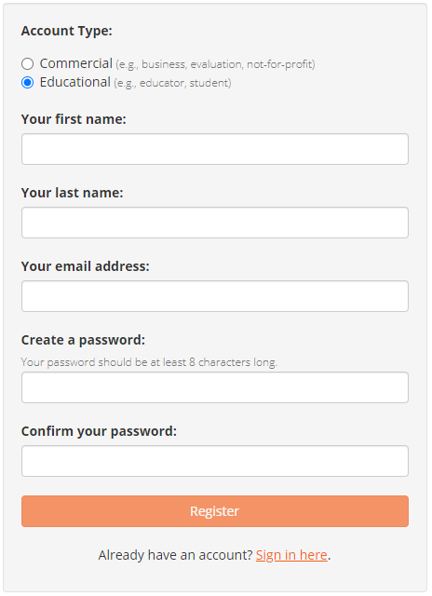
RapidMiner - Installation
Step 4. Register an Educational Licence in this link:
https://my.rapidminer.com/nexus/account/index.html#signup?returnUrl=https%3A%2F%2Fmy.rapidminer.com%2Fnexus%2Faccount%2Findex.html%23home
Educational Licence will give you free access to the software.
Use your ADFA email to register for this educational licence

Slide 10
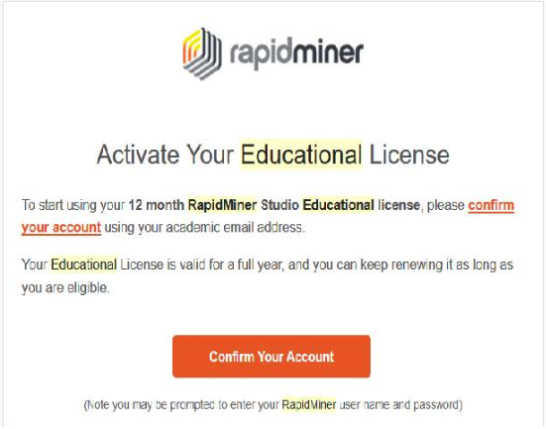
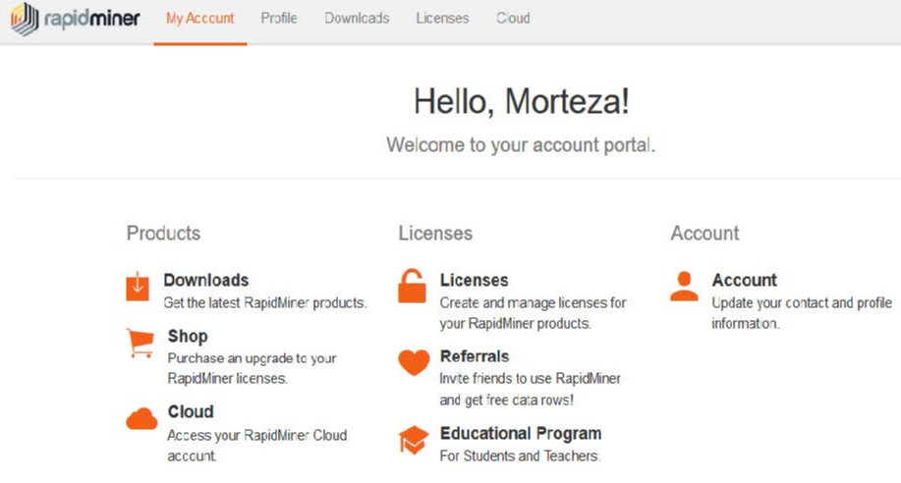
RapidMiner - Installation
Step 5. Confirm your account.
You will be able to login to your own page now.
You should receive an email after registration. Confirm your account by clicking this button.

Slide 11
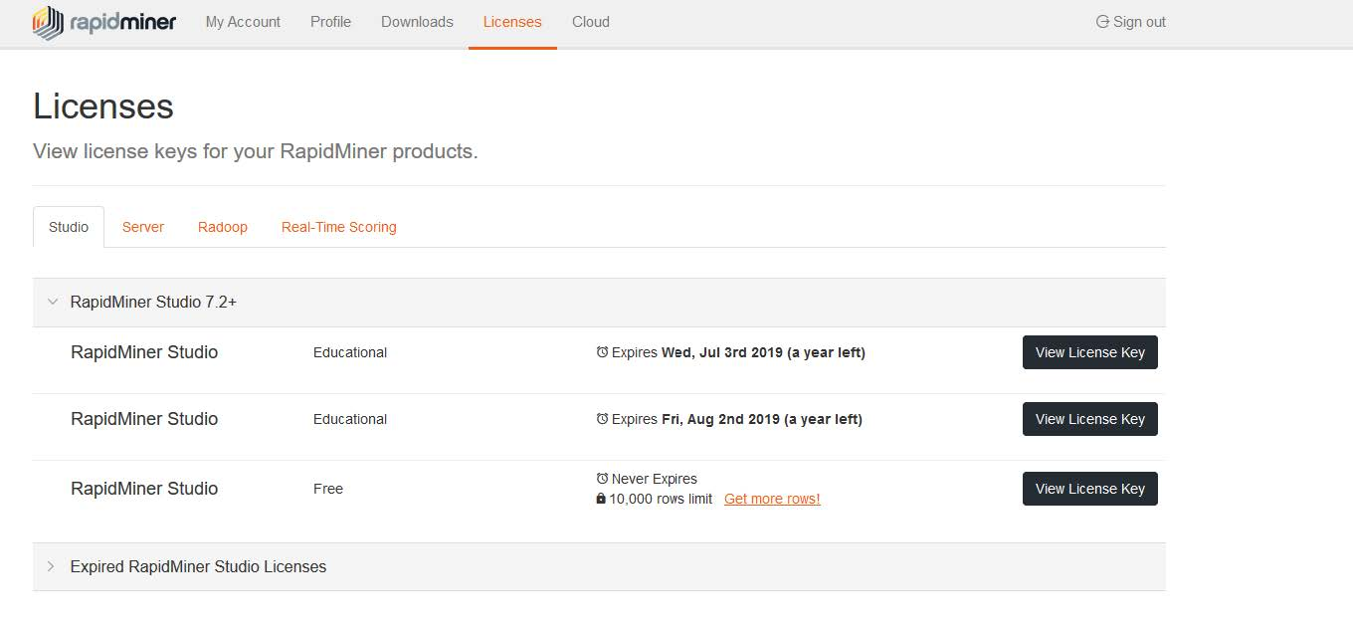
RapidMiner - Installation
Step 6. Copy your educational licence to the software on your machine.
Switch to the Licences page
Then view your Licence Key here

Slide 12
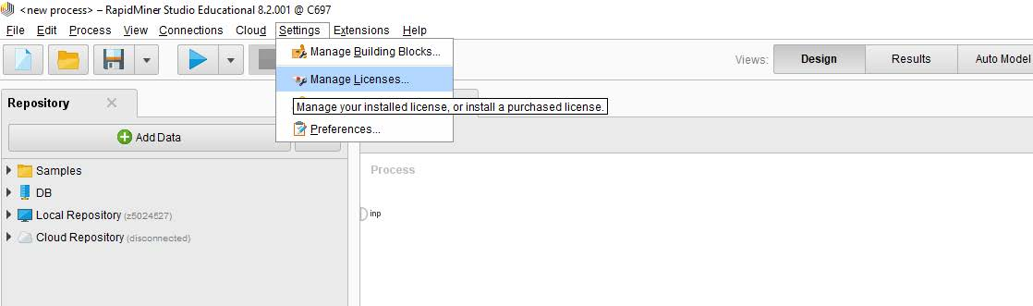
RapidMiner - Installation
Step 7. Copy your educational licence to the software on your machine.
Turn on the RapidMiner software on your machine. Select Settings, then go to Manage Licenses.

Slide 13
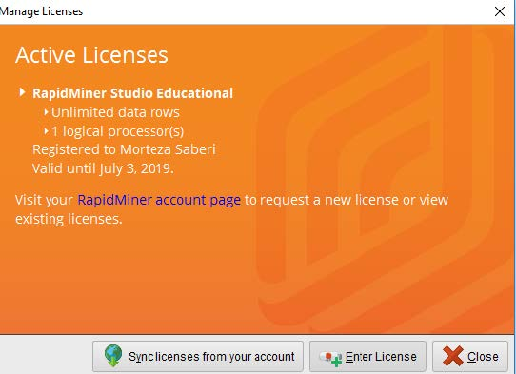
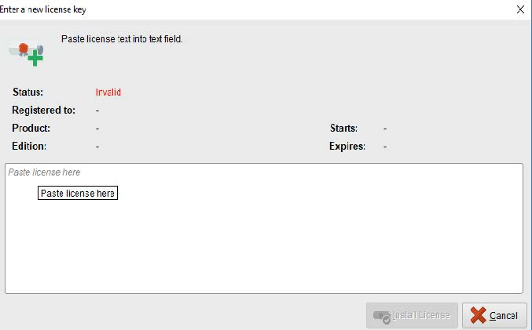
RapidMiner - Installation
Step 8. Copy your educational licence to the software on your machine.
Paste your educational licence here.
Click on the Enter Licence
After these 6 steps, you will be able to access the full function of the RapidMiner software for one year.
You can always renew your licence within the validation period of your ADFA email.
If you have trouble installing or registering RapidMiner, feel free to contact me.

Slide 14
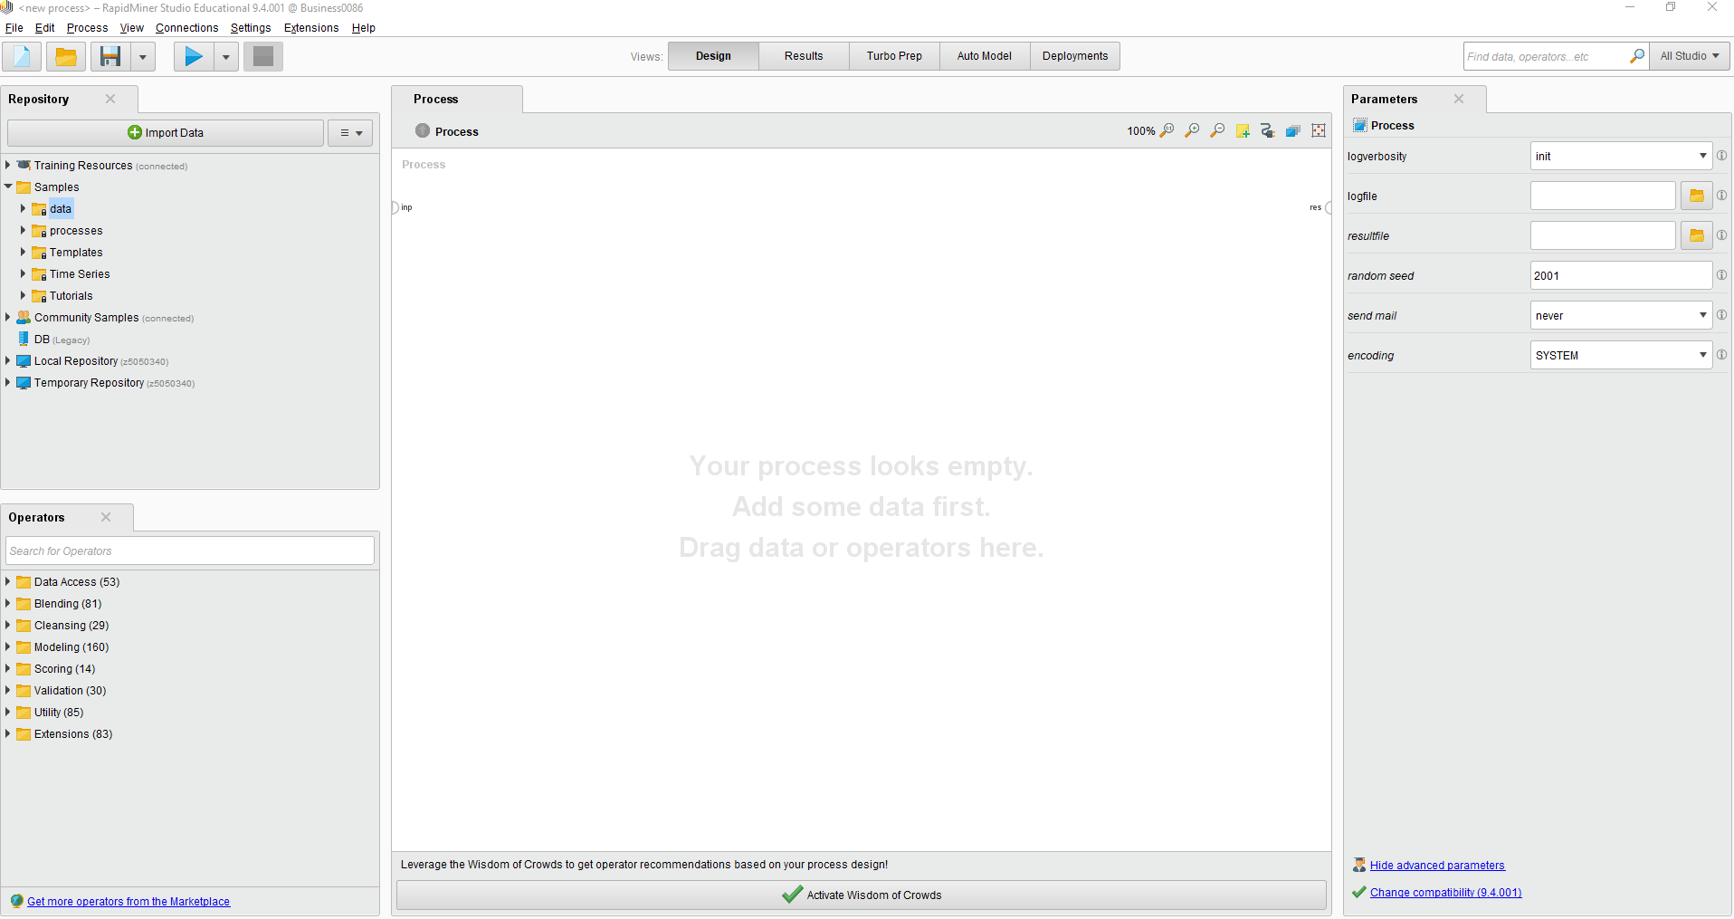
RapidMiner - Interface
Four modes of the software
The Repository panel contains the datasets and some codes
Feel free to play around the software.
Parameters which are needed for the models
The Operation panel contains the models that you can operate on your data.

Slide 15
Data Preparation with RapidMiner

Slide 16
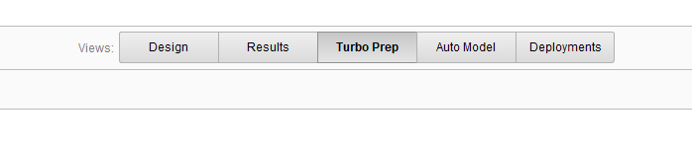
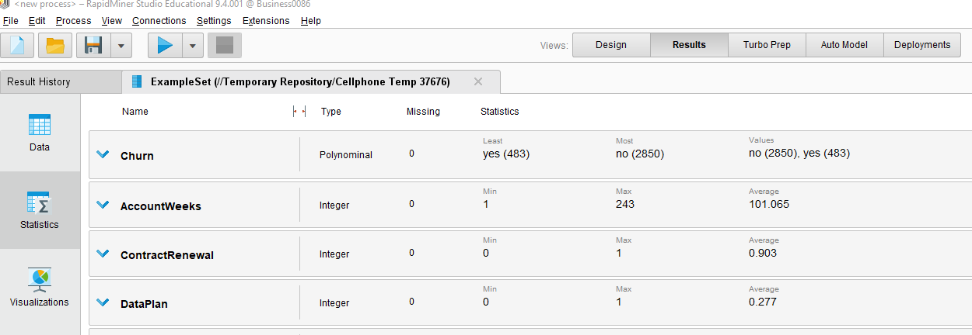
Data Preparation
For data preparation, we mainly use the Turbo Prep mode
and Statistics & Visualisations functions under the Results mode.

Slide 17
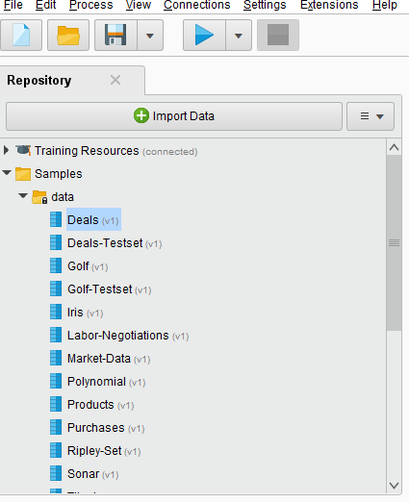
Data Preparation – Descriptive Statistics
In the Repository panel, there are some default datasets available to use.
Double-click on any targeted dataset, the new windows will pop up under Results Mode.
You can see Descriptive Statistic when clicking on the Statistics button to the left side of the window.
Double click on any dataset

Slide 18
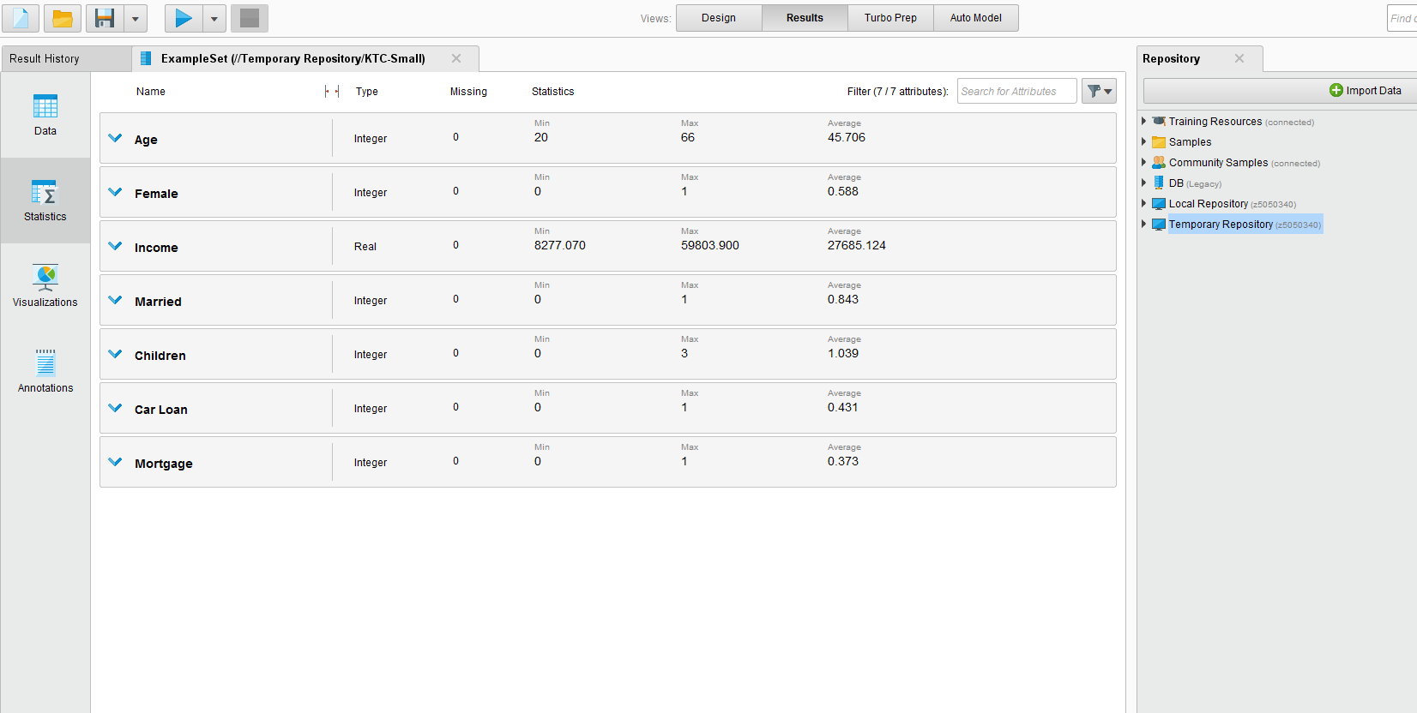
Data Preparation – Descriptive Statistics
Statistics
Results

Slide 19
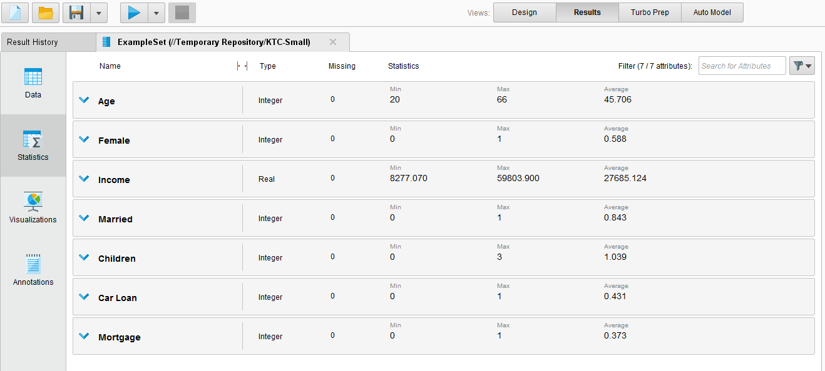
Data Preparation – Descriptive Statistics
Type
Missing
Statistics

Slide 20
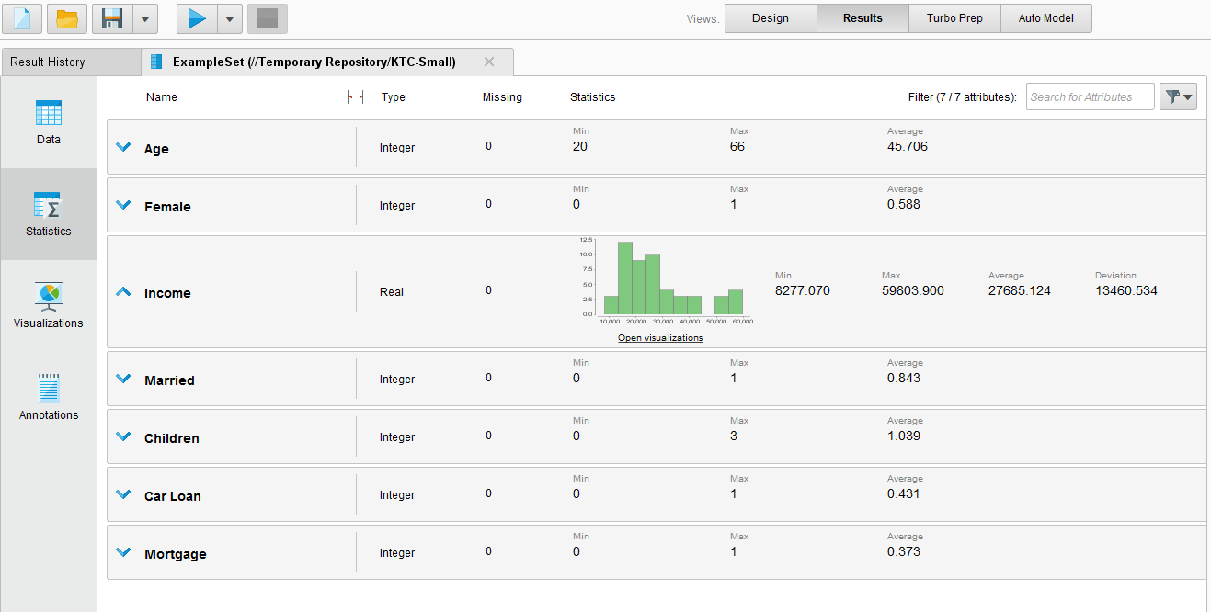
Data Preparation – Descriptive Statistics
Clicking on any row to show frequency distribution

Slide 21
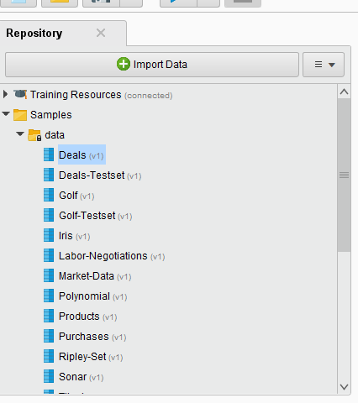

Data Preparation – Descriptive Statistics
Example: Who spent more money?
Use the Deals dataset

Slide 22
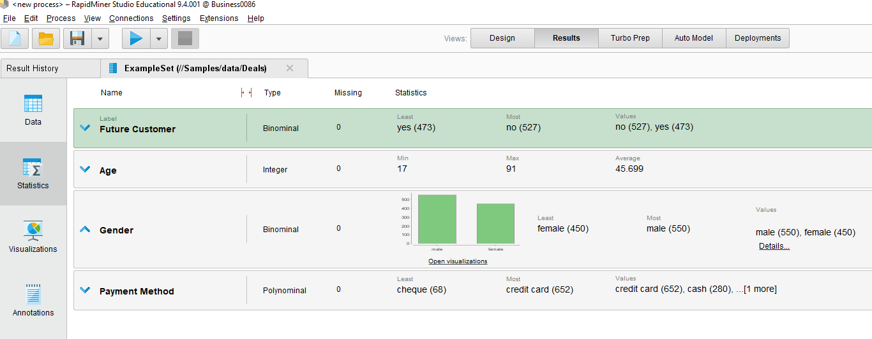
Data Preparation – Descriptive Statistics
Example: Who spent more money?
Choose the Gender statistics
After you see a small histogram, click on the Open visualizations.

Slide 23
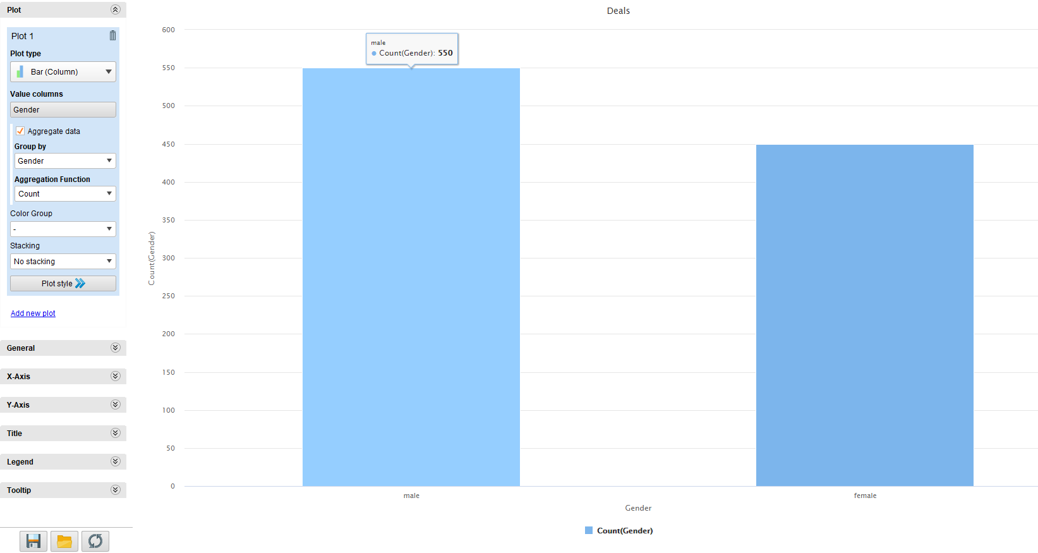

Data Preparation – Descriptive Statistics
Example: Who spent more money?
You will see an operational diagram plotting the Deal dataset distributed by the Gender attribute.
Notes:
Note: At this step, you already know Males have made more deals than the Females.

Slide 24
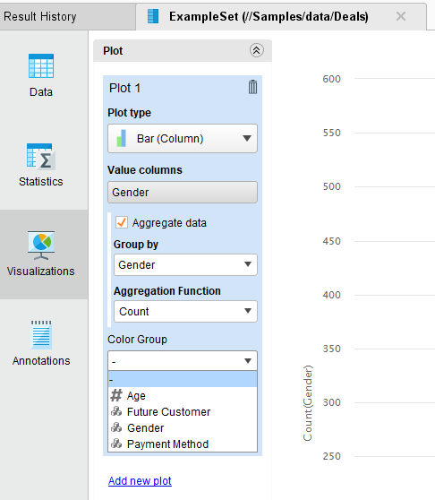
Data Preparation – Descriptive Statistics
Example: Who spent more money?
Now, let’s see, amongst the male and female individuals, who are the Future Customers.

Slide 25
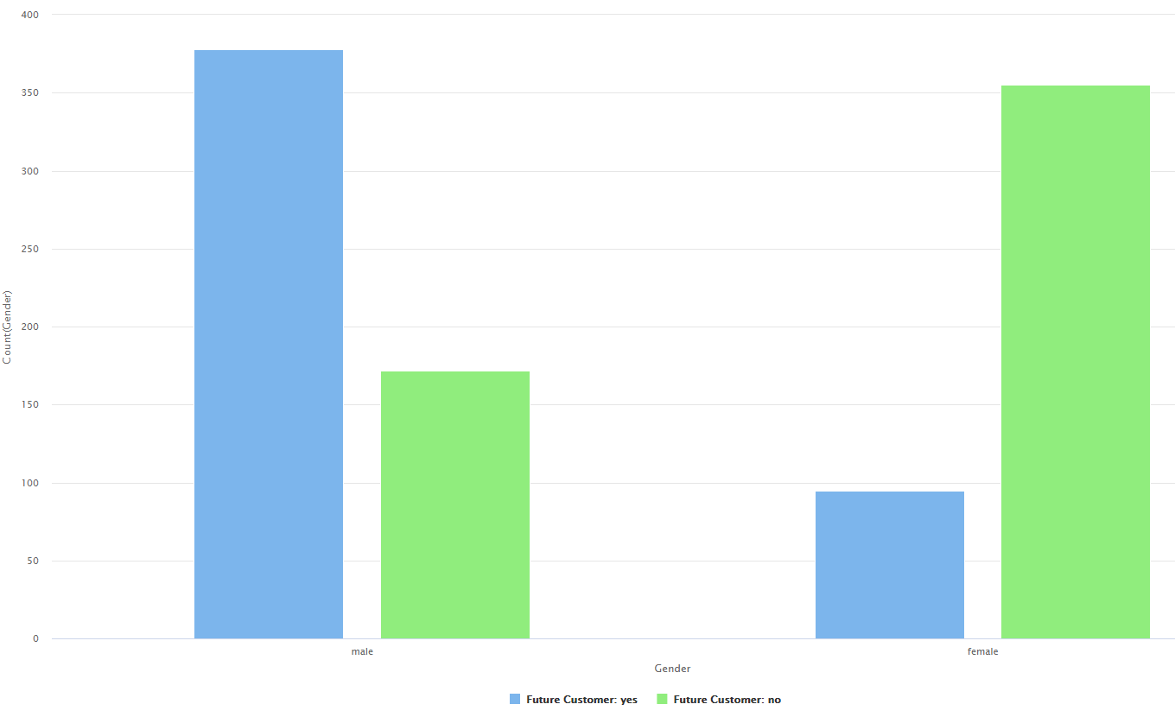
Data Preparation – Descriptive Statistics
Example: Who spent more money?
Not only have the Males made more deals, they tend to be the Future Customers!

Slide 26
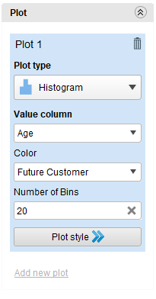
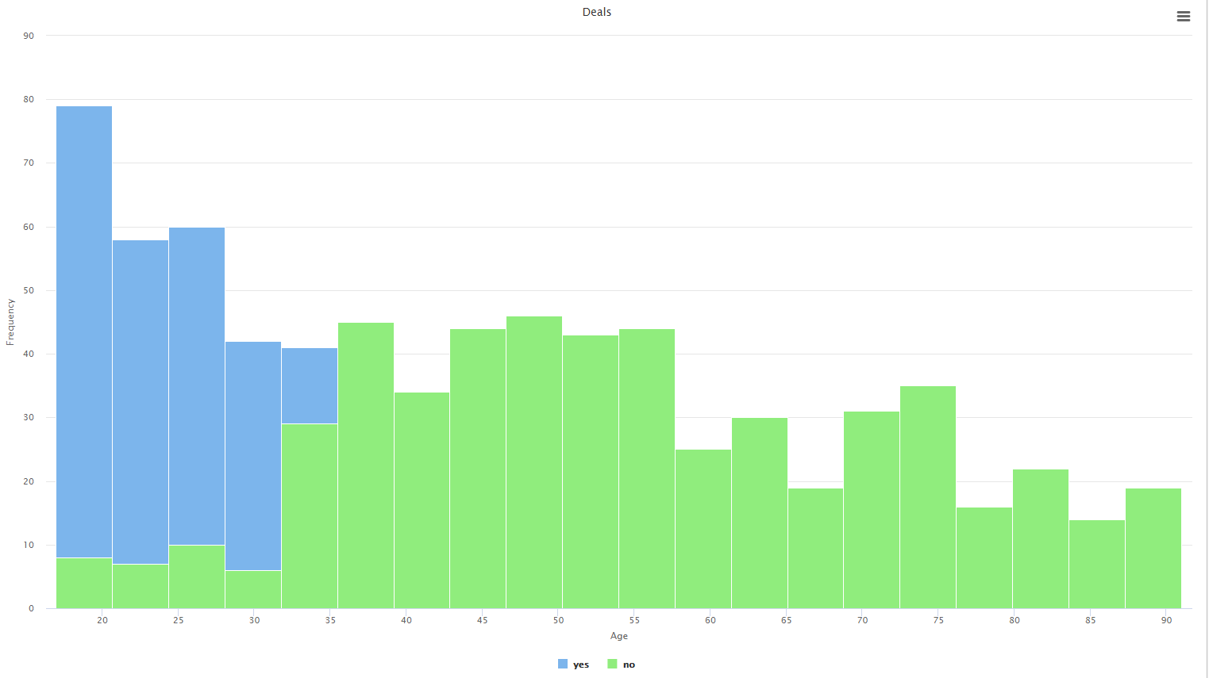

Data Preparation – Descriptive Statistics
Example: Who spent more money?
Similar operation, using this setup, we can see younger individuals tend to be the Future Customers.

Slide 27
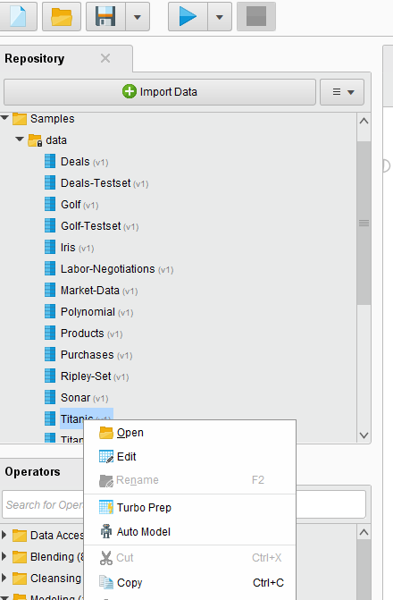
Data Preparation – Turbo Prep
The second method for data preparation in RapidMiner is through Turbo Prep

Slide 28
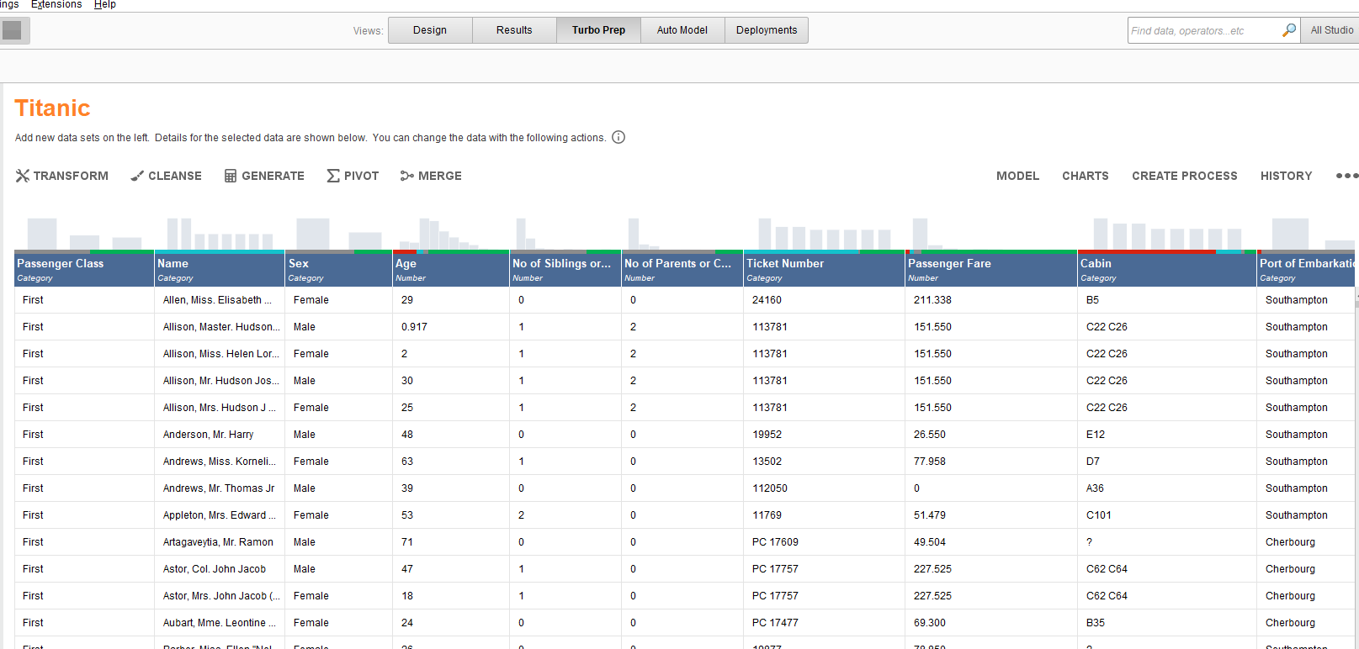
Data Preparation – Turbo Prep
We can do Transform, Cleanse, Generate, Pivot and Merge operations on any dataset.

Slide 29
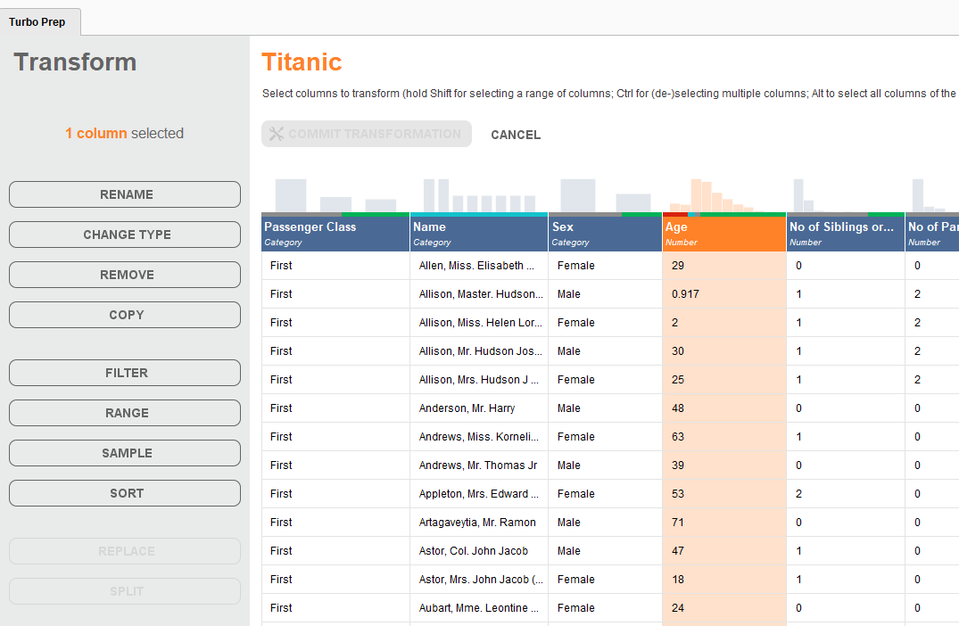
Data Preparation – Turbo Prep
We can do these operations under the Transform function.

Slide 30
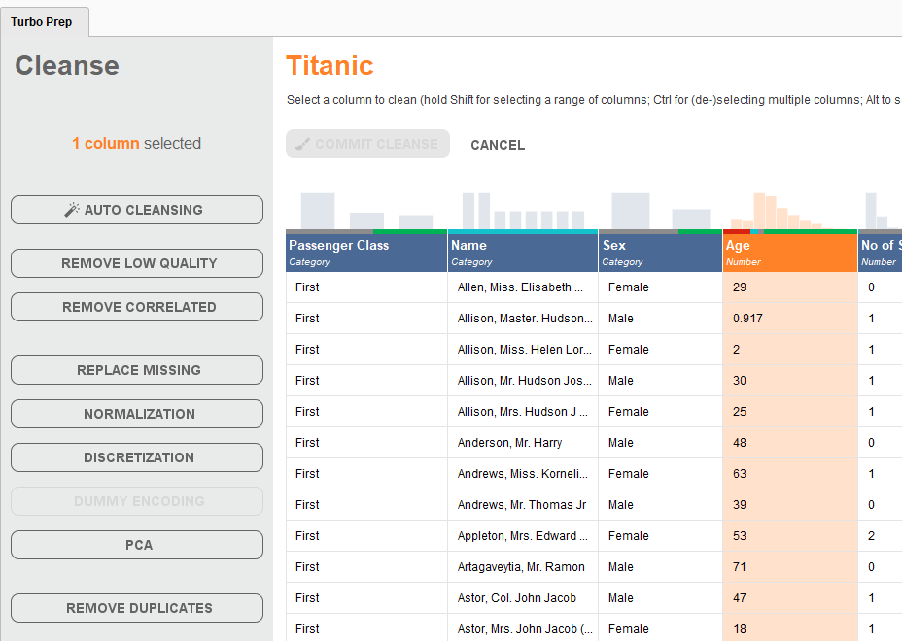
Data Preparation – Turbo Prep
Under the Cleanse function, we have more operations to handle our datasets.

Slide 31
Conclusion and Notes
A proper data preparation is very important for the results of business analytics.
This week, we mainly focus on the introduction of RapidMiner, and how to use it for descriptive data plotting and organising.
In this week’s collaborative session, we will show more details of how to use RapidMiner and Orange. Feel free to join us.

